Slide 1
Milestones 1 & 2 - Analysis
Machine Learning (MAC-LRN)
Arevalo, Mark Anthony
Nablo, Juan Paolo
Vivo, Roi Emmanuel

Slide 2
Dataset
Spambase - Spam Mail Detection
Diabetic Retinopathy

Slide 3
Goals
The main objective of this research is to analyze the Spambase and Diabetic Retinopathy datasets.
For the Spambase dataset, the goal is to understand the characteristics that can help consider what a spam email is or not.
The Diabetic Retinopathy dataset, on the other hand, aims to comprehend the features that affects the prediction of diabetic retinopathy.

Slide 4
Machine Learning Techniques
Milestone 1
Complete Feature Set, Forward Search, Backward Elimination, PCA.
kNN (k = 1, 3, 5, 7 ,9)
Decision Trees
Bayesian Network
MLP
SVM
Milestone 2
k-Means Clustering
SOM

Slide 5
Dataset 1: SPAMBASE

Slide 6
Milestone 1: Spambase
Dataset Building and Normalization
Source of Dataset: UCI Machine Learning Repository
Description of Dataset (include the number of original features and the sample size):
This dataset contains a collection of spam emails from a set of individuals who have filed spam to the owner’s postmaster. Within the dataset, there exists a collection of non-spam emails as well. There are 4601 samples and 58 features.

Slide 7
Milestone 1: Spambase
3. Name, Description and type of each feature. Include here if you had to normalize the feature, the reason for its normalization and the range of values (e.g. 0 to 1).

Slide 8
MILESTONE 1: SPambase
A-AV | 48 continuous real [0,100] attributes of type word_freq_WORD
 | percentage of words in the e-mail that match WORD, i.e. 100 * (number of times the WORD appears in the e-mail) / total number of words in e-mail. A "word" in this case is any string of alphanumeric characters bounded by non-alphanumeric characters or end-of-string.
AW-BB | 6 continuous real [0,100] attributes of type char_freq_CHAR
 | percentage of characters in the e-mail that match CHAR, i.e. 100 * (number of CHAR occurences) / total characters in e-mail
BC | 1 continuous real [1,...] attribute of type capital_run_length_average
 | average length of uninterrupted sequences of capital letters
BD | 1 continuous integer [1,...] attribute of type capital_run_length_longest
 | length of longest uninterrupted sequence of capital letters
BE | 1 continuous integer [1,...] attribute of type capital_run_length_total
 | sum of length of uninterrupted sequences of capital letters
 | total number of capital letters in the e-mail
BF | 1 nominal {0,1} class attribute of type spam
 | denotes whether the e-mail was considered spam (1) or not (0), i.e. unsolicited commercial e-mail.

Slide 9
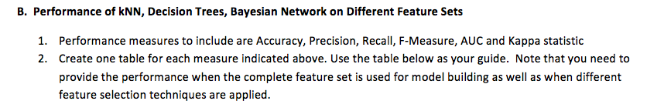
MILESTONE 1: SPambase
Complete Feature Set
Feature Selection using Forward Selection and Backward Elimination
PCA

Slide 10
CFS
 | Accuracy | Precision | Recall | F-Measure | AUC | Kappa
kNN (k=1) | 90.31 | 91.92% | 92.14% | 92.02% | 0.5 | 0.797
kNN (k=3) | 90.35 | 91.15% | 93.15% | 92.13% | 0.919 | 0.797
kNN (k=5) | 89.94 | 90.81% | 92.83% | 91.79% | 0.936 | 0.788
kNN (k=7) | 89.63 | 90.49% | 92.65% | 91.54% | 0.953 | 0.782
kNN (k=9) | 89.24 | 89.63% | 93.04% | 91.29% | 0.954 | 0.772
Decision Trees | 88.35 | 85.81% | 96.88% | 90.99% | 0.864 | 0.747
Bayesian Network (e.g. Naïve Bayes) | 79.79 | 96.74% | 68.97% | 80.51% | 0.934 | 0.607
MLP (Training Cycles = 10) | 91.28% | 90.71% | 87.20% | 88.70% | 0.959 | 0.816
SVM | 89.78% | 93.09% | 80.08% | 86.04% | 0.962 | 0.781
Backward
 | Accuracy | Precision | Recall | F-Measure | AUC | Kappa
kNN (k=1) | 91.09 | 92.66% | 92.65% | 92.64% | 0.5 | 0.813
kNN (k=3) | 91.33 | 91.91% | 93.97% | 92.92% | 0.919 | 0.817
kNN (k=5) | 90.87 | 91.64% | 93.47% | 92.54% | 0.935 | 0.808
kNN (k=7) | 91.37 | 91.98% | 93.97% | 92.95% | 0.955 | 0.818
kNN (k=9) | 90.85 | 91.31% | 93.87% | 92.56% | 0.958 | 0.807
Decision Trees | 90.55 | 90.14% | 94.84% | 92.40% | 0.907 | 0.799
Bayesian Network (e.g. Naïve Bayes) | 82.81 | 95.94% | 74.82% | 84.05% | 0.936 | 0.66
MLP (Training Cycles = 10)
SVM | 91.28% | 91.03% | 94.98% | 92.96% | 0.815 | 0.959
Forward
 | Accuracy | Precision | Recall | F-Measure | AUC | Kappa
kNN (k=1) | 89.57 | 93.01% | 89.53% | 91.22% | 0.5 | 0.784
kNN (k=3) | 91.92 | 92.91% | 93.83% | 93.36% | 0.925 | 0.83
kNN (k=5) | 92.44 | 93.42% | 94.19% | 93.79% | 0.946 | 0.841
kNN (k=7) | 92.24 | 93.48% | 93.76% | 93.61% | 0.969 | 0.837
kNN (k=9) | 91.91 | 92.73% | 94.05% | 93.38% | 0.958 | 0.83
Decision Trees | 90.59 | 89.13% | 96.23% | 92.54% | 0.891 | 0.798
Bayesian Network (e.g. Naïve Bayes) | 81.79 | 79.65% | 94.01% | 86.22% | 0.872 | 0.599
MLP (Training Cycles = 10)
SVM | 89.22% | 89.40% | 93.29% | 91.29% | 0.953 | 0.772
PCA
 | Accuracy | Precision | Recall | F-Measure | AUC | Kappa
kNN (k=1) | 72.09 | 86.03% | 64.42% | 73.66% | 0.5 | 0.453
kNN (k=3) | 71.85 | 85.14% | 64.89% | 73.63% | 0.756 | 0.446
kNN (k=5) | 72.03 | 84.88% | 65.53% | 73.93% | 0.766 | 0.448
kNN (k=7) | 71.72 | 84.37% | 65.46% | 73.69% | 0.771 | 0.442
kNN (k=9) | 72.03 | 84.44% | 66.03% | 74.09% | 0.769 | 0.447
Decision Trees | 82.03 | 84.21% | 86.62% | 85.37% | 0.853 | 0.621
Bayesian Network (e.g. Naïve Bayes) | 62.51 | 97.36% | 39.20% | 55.85% | 0.846 | 0.324
MLP (Training Cycles = 10) | 80.72% | 82.72% | 86.26% | 84.42% | 0.875 | 0.592
SVM | 68.46% | 77.99% | 56.62% | 65.35% | 0.757 | 0.378

Slide 11
C. Discussion of Results
By analysing the data, Feature Selection using Forward Search with kNN (k=5) is found to be the best classifier.
Feature Selection using Forward Search has greater performance and more consistent values compared to other processes.
MLP, Decision Trees and Bayesian Network for all processes did not give greater results compared to kNN.
 | Accuracy | Precision | Recall | F-Measure | AUC | Kappa
kNN (k=5) | 92.44 | 93.42% | 94.19% | 93.79% | 0.946 | 0.841
SVM | 91.28% | 91.03% | 94.98% | 92.96% | 0.815 | 0.959
Decision Trees | 82.03 | 84.21% | 86.62% | 85.37% | 0.853 | 0.621

Slide 12
PCA top 9
A-AV | 48 continuous real [0,100] attributes of type word_freq_WORD
 | percentage of words in the e-mail that match WORD, i.e. 100 * (number of times the WORD appears in the e-mail) / total number of words in e-mail. A "word" in this case is any string of alphanumeric characters bounded by non-alphanumeric characters or end-of-string.
AW-BB | 6 continuous real [0,100] attributes of type char_freq_CHAR
 | percentage of characters in the e-mail that match CHAR, i.e. 100 * (number of CHAR occurences) / total characters in e-mail
BC | 1 continuous real [1,...] attribute of type capital_run_length_average
 | average length of uninterrupted sequences of capital letters
BD | 1 continuous integer [1,...] attribute of type capital_run_length_longest
 | length of longest uninterrupted sequence of capital letters
BE | 1 continuous integer [1,...] attribute of type capital_run_length_total
 | sum of length of uninterrupted sequences of capital letters
 | total number of capital letters in the e-mail
BF | 1 nominal {0,1} class attribute of type spam
 | denotes whether the e-mail was considered spam (1) or not (0), i.e. unsolicited commercial e-mail.
Top 9 PCA
AA
U
AH
AN
AF
AD
S
Y
C

Slide 13
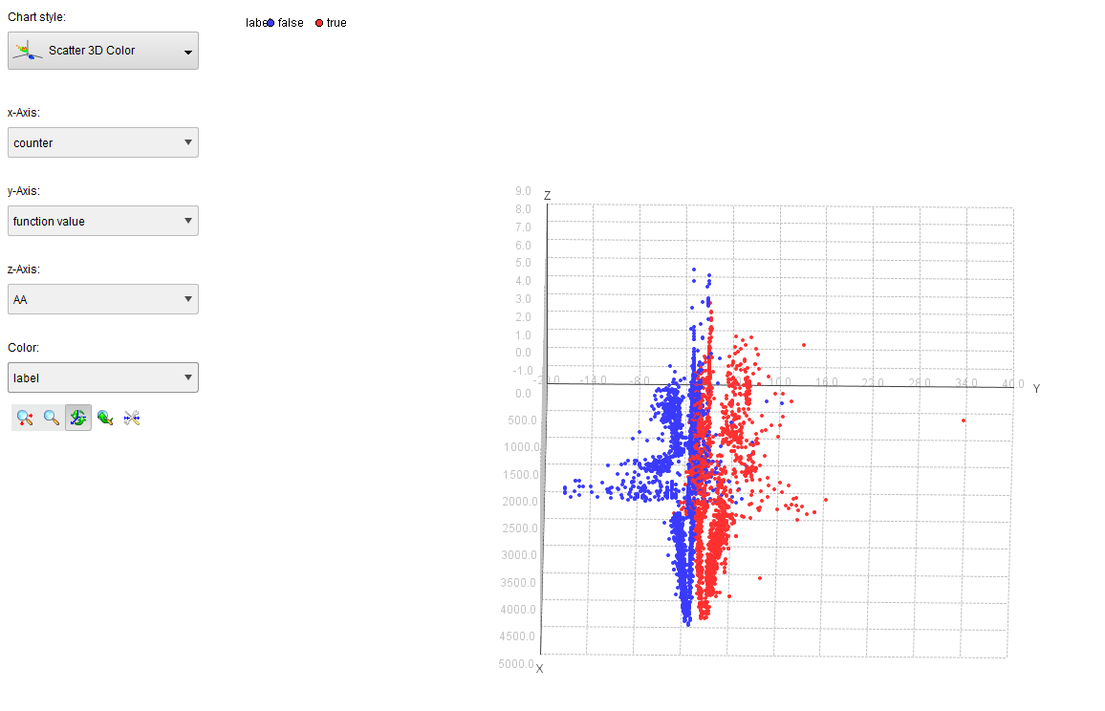
Figure 8 – SVM Results

Slide 14
MILEstone 1: SPAMBASE
Based on the SVM results above, true and false nodes are visible. The color blue indicates that the node is not a spam while the red nodes illustrate a spam instance.

Slide 15
MILESTONE 2: SPAMBASE

Slide 16
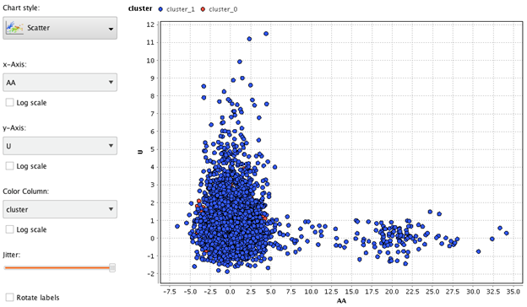
k-Means Clustering: Spambase
From different tested clusters, k = 20 shows different clustered data
When k = 2

Slide 17
k-Means Clustering: Spambase
Cluster | Number of samples
0 | 244
1 | 4357
Total | 4601

Slide 18
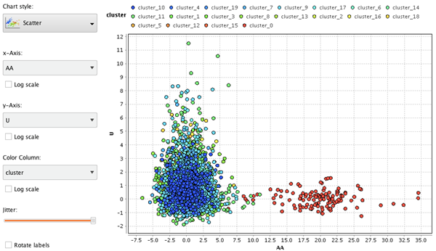
k-Means Clustering: Spambase
When k = 20

Slide 19
k-Means Clustering: Spambase
Cluster | Number of samples | Cluster | Number of samples | Cluster | Number of samples
0 | 128 | 8 | 99 | 16 | 60
1 | 193 | 9 | 746 | 17 | 511
2 | 47 | 10 | 245 | 18 | 40
3 | 620 | 11 | 923 | 19 | 37
4 | 107 | 12 | 46
5 | 70 | 13 | 189
6 | 71 | 14 | 130
7 | 334 | 15 | 5

Slide 20
k-Means Clustering: Spambase
K= 20 was chosen because all clusters from 2 to 19 produced similar results
Solution may become better if k > 20
Data were more similar than dissimilar
Because of this issue, classes are difficult to distinguish

Slide 21
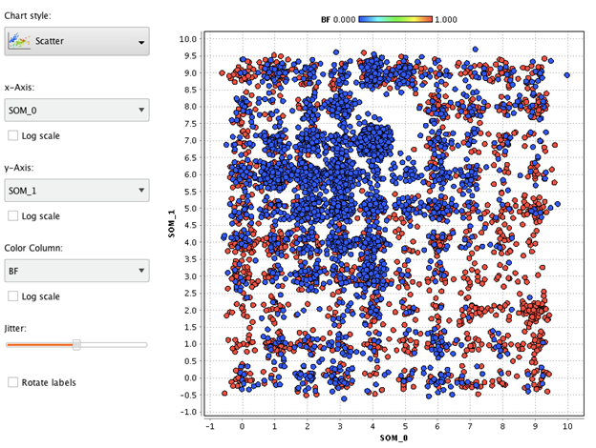
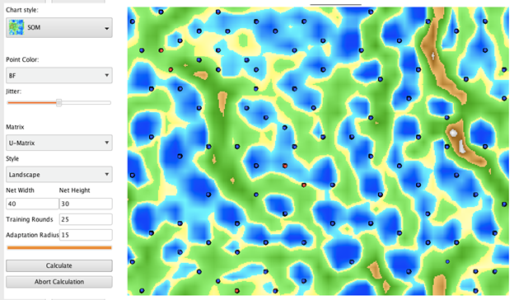
SOM: Spambase
Scatter Plot & SOM - 1,000 Training Rounds

Slide 22
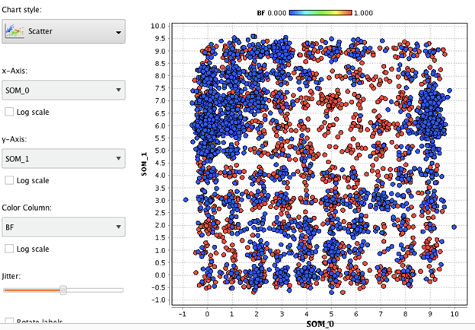
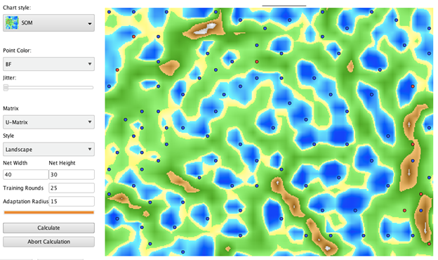
SOM: Spambase
Scatter Plot & SOM - 10,000 Training Rounds

Slide 23
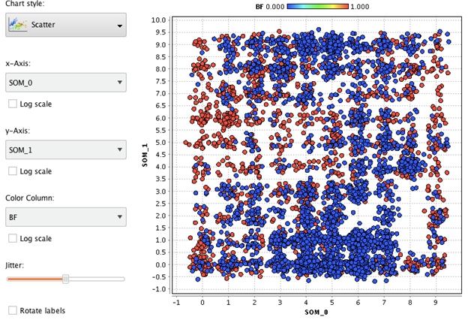
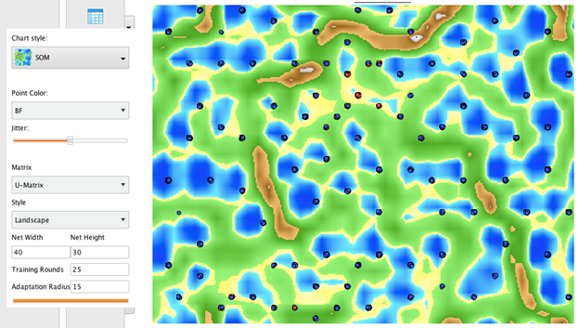
SOM: Spambase
Scatter Plot & SOM - 15,000 Training Rounds

Slide 24
SOM: Spambase
Based on all the maps, it is difficult to distinguish what kind of samples are assigned to the parts of the map especially with no labels on it.
Just like the clustering process, the maps are unorganized though the map with 1000 training rounds is more “clean” compared to the others.

Slide 25
SOM: Spambase
Even with unsupervised learning, the dataset was still unorganized due to similarities of the data in the features. The data can still be used for analysis, but it will not be as accurate for predictions.

Slide 26
Dataset 2: DIABETic retinopathy

Slide 27
Milestone 1: Diabetic Retinopathy
Dataset Building and Normalization
Source of Dataset:
UCI Machine Learning Repository – Center for Machine Learning and Intelligent Systems http://archive.ics.uci.edu/ml/datasets/Diabetic+Retinopathy+Debrecen+Data+Set
Dr. Balint Antal, Department of Computer Graphics and Image Processing Faculty of Informatics, University of Debrecen, 4010, Debrecen, POB 12, Hungary antal.balint '@' inf.unideb.hu
Dr. Andras Hajdu, Department of Computer Graphics and Image Processing Faculty of Informatics, University of Debrecen, 4010, Debrecen, POB 12, Hungary hajdu.andras '@' inf.unideb.hu

Slide 28
Milestone 1: Diabetic Retinopathy
Description of Dataset:
Number of original features - 20
Sample size - 1151
This dataset contains features extracted from the Messidor image set to predict whether an image contains signs of diabetic retinopathy or not. All features represent either a detected lesion, a descriptive feature of a anatomical part or an image-level descriptor. The underlying method image analysis and feature extraction as well as our classification technique is described in Balint Antal, Andras Hajdu: An ensemble-based system for automatic screening of diabetic retinopathy, Knowledge Based Systems 60 (April 2014), 20-27.

Slide 29
Milestone 1: Diabetic Retinopathy
Name, Description, and Type of each feature:
A - Result of Quality Assessment
Continuous Real = [0 - 1]
B - Result of Pre-screening
Continuous Real = [0 - 1]
C-H - Results of MA detection
Continuous Real = [0 - 1]
I-P - Results of MA detection for exudates
Continuous Real = [0 - 1]
Q - Euclidean distance of the center of the macula and the center of the optic disc
Continuous Real = [0 - 1]
R - The diameter of the optic disc
Continuous Real = [0 - 1]
S - The binary result of the AM/FM-based classification
Continuous Real = [0 - 1]
T - Class
Binomial ⊆ [false, true]
The attributes were set from Numerical to Binomial, from Nominal to Numerical, and then normalized to attain a linear and more robust relationship.

Slide 30
Milestone 1: Diabetic Retinopathy
Complete Feature Set
Feature Selection using Forward Selection and Backward Elimination
PCA

Slide 31
C. Discussion of Results
Complete Feature Set
Feature Selection using Forward Selection and Backward Elimination
PCA

Slide 32
CFS
 | Accuracy | Precision | Recall | F-Measure | AUC | Kappa
kNN (k=1) | 61.25 | 64.40 | 60.39 | 62.33 | 0.5 | 0.225
kNN (k=3) | 62.29 | 65.83 | 60.23 | 62.91 | 0.66 | 0.247
kNN (k=5) | 63.16 | 66.91 | 60.56 | 63.57 | 0.68 | 0.265
kNN (k=7) | 64.73 | 68.60 | 61.87 | 65.06 | 0.694 | 0.296
kNN (k=9) | 63.94 | 67.88 | 60.88 | 64.19 | 0.696 | 0.281
Decision Trees | 53.69 | 56.27 | 57.28 | 56.77 | 0.549 | 0.069
Bayesian Network (e.g. Naïve Bayes) | 60.30 | 81.56 | 32.57 | 46.55 | 0.689 | 0.233
MLP (Training Cycles = 10) | 70.46 | 79.90 | 60.24 | 68.21 | 0.797 | 0.416
SVM
Backward
 | Accuracy | Precision | Recall | F-Measure | AUC | Kappa
kNN (k=1) | 63.34% | 66.67% | 61.87% | 64.18% | 0.5 | 0.267
kNN (k=3) | 64.47% | 68.23% | 61.87% | 64.89% | 0.675 | 0.291
kNN (k=5) | 66.20% | 70.48% | 62.52% | 66.26% | 0.703 | 0.326
kNN (k=7) | 68.03% | 71.97% | 65.14% | 68.38% | 0.717 | 0.362
kNN (k=9) | 65.94% | 70.02% | 62.68% | 66.15% | 0.708 | 0.321
Decision Trees | 54.39% | 58.24% | 49.75% | 53.66% | 0.565 | 0.093
Bayesian Network (e.g. Naïve Bayes) | 65.07% | 74.59% | 51.88% | 61.20% | 0.7 | 0.313
MLP (Training Cycles = 10) | 72.72% | 78.9% | 66.95% | 72.14% | 0.804 | 0.458
SVM
Forward
 | Accuracy | Precision | Recall | F-Measure | AUC | Kappa
kNN (k=1) | 68.20 | 71.60 | 66.45 | 68.93 | 0.5 | 0.365
kNN (k=3) | 71.42 | 75.09 | 69.07 | 71.95 | 0.736 | 0.429
kNN (k=5) | 72.20 | 76.89 | 68.09 | 72.22 | 0.771 | 0.446
kNN (k=7) | 70.89 | 75.75 | 66.45 | 70.79 | 0.761 | 0.42
kNN (k=9) | 70.89 | 76.85 | 64.65 | 70.22 | 0.767 | 0.422
Decision Trees | 54.39 | 53.80 | 99.67 | 69.88 | 0.548 | 0.03
Bayesian Network (e.g. Naïve Bayes) | 65.68 | 73.28 | 55.65 | 63.26 | 0.678 | 0.322
MLP (Training Cycles = 10) | 73.41 | 80.98 | 67.10 | 72.66 | 0.8 | 0.47
SVM
PCA
 | Accuracy | Precision | Recall | F-Measure | AUC | Kappa
kNN (k=1) | 67.16% | 69.19% | 68.74% | 68.97% | 0.3 | 0.341
kNN (k=3) | 64.64% | 67.59% | 64.16% | 65.83% | 0.684 | 0.292
kNN (k=5) | 65.68% | 69.22% | 63.67% | 66.33% | 0.713 | 0.315
kNN (k=7) | 67.33% | 71.10% | 64.81% | 67.81% | 0.725 | 0.348
kNN (k=9) | 68.20% | 72.15% | 65.20% | 68.56% | 0.731 | 0.366
Decision Trees | 53.26% | 53.54% | 90.34% | 67.23% | 0.529 | 0.017
Bayesian Network (e.g. Naïve Bayes) | 59.77% | 64.45% | 54.01% | 58.77% | 0.652 | 0.201
MLP (Training Cycles = 10) | 69.50% | 79.09% | 59.23% | 66.66% | 0.776 | 0.396
SVM

Slide 33
C. Discussion Of Results
Based on the results, the following characteristics were observed:
In the Complete Feature Set, MLP was the best classifier.
In the Feature Selection Forward Search, MLP was the best classifier.
In the Feature Selection Backward Search, MLP was the best classifier.
In PCA, MLP was the best classifier.
This shows that overall, MLP was the best classifier.

Slide 34
PCA top 9
Top 9 PCA
B
S
F
E
D
G
C
H
I
A - Result of Quality Assessment
Continuous Real = [0 - 1]
B - Result of Pre-screening
Continuous Real = [0 - 1]
C-H - Results of MA detection
Continuous Real = [0 - 1]
I-P - Results of MA detection for exudates
Continuous Real = [0 - 1]
Q - Euclidean distance of the center of the macula and the center of the optic disc
Continuous Real = [0 - 1]
R - The diameter of the optic disc
Continuous Real = [0 - 1]
S - The binary result of the AM/FM-based classification
Continuous Real = [0 - 1]
T - Class
Binomial ⊆ [false, true]

Slide 35
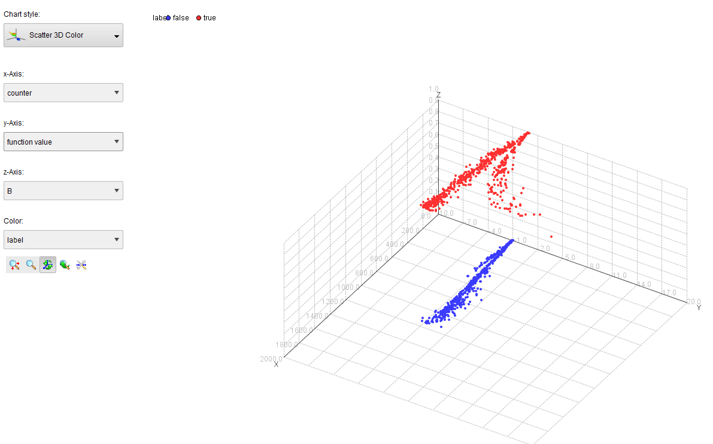
Figure 8 – SVM Results

Slide 36
Based on the SVM results above, true and false nodes are visible. The color blue indicates that the node is negative of diabetic retinopathy while the red nodes illustrates otherwise.

Slide 37
MILESTONE 2: DIABETIC RETINOPATHY

Slide 38
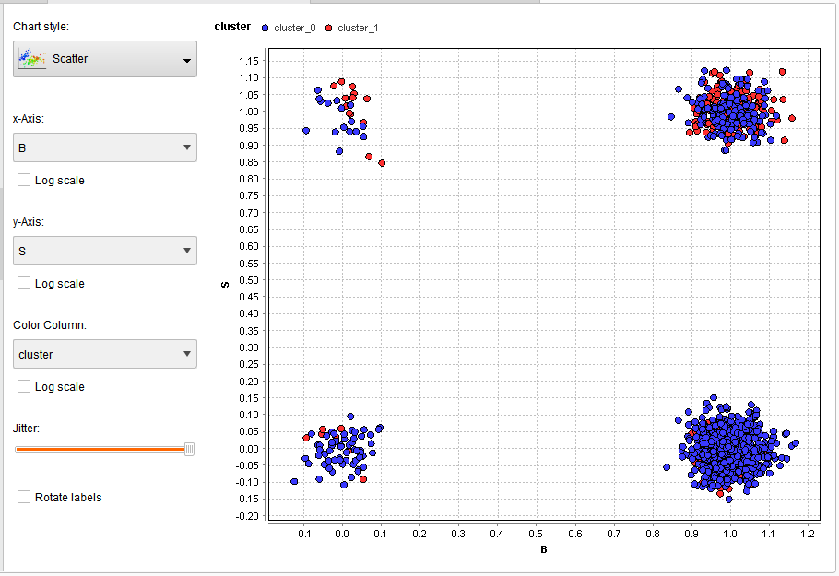
K-means Clustering: Diabetic Retinopathy
Since the features B and S was found out to be the top features based on PCA, it can be observed that at K = 2, x-axis = B, and y-axis = S, the two clusters merge with each other.

Slide 39
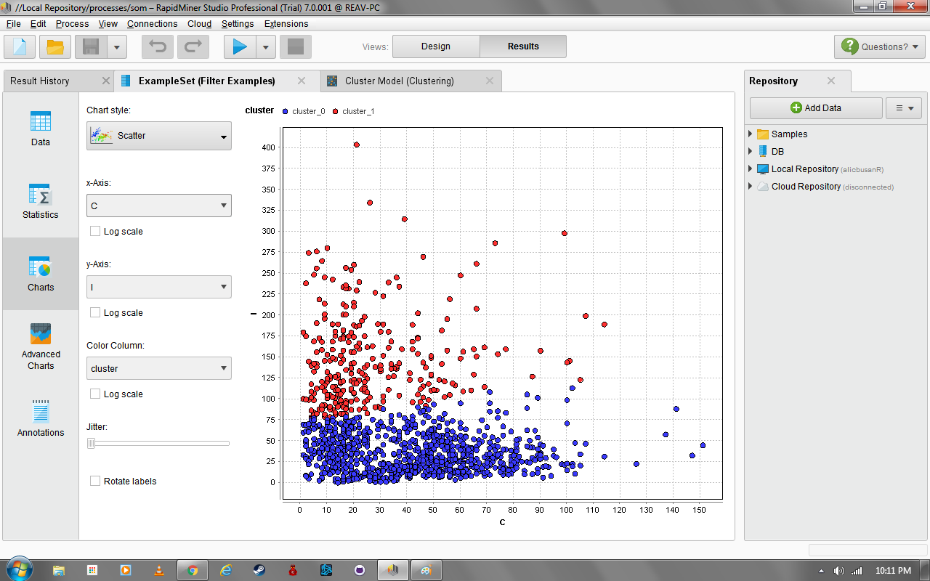
k-Means Clustering: Diabetic Retinopathy
From different tested clusters, k = 2 shows different clustered data

Slide 40
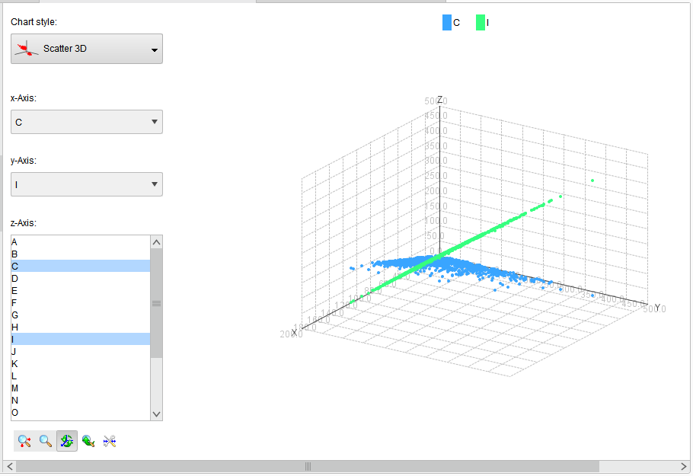
K-means Clustering: Diabetic Retinopathy
The solution to this is that the clusters where displayed in a higher-dimension plot to fully separate each clusters.

Slide 41
k-Means Clustering: Diabetic Retinopathy
Cluster | Number of samples
0 | 292
1 | 859

Slide 42
k-Means Clustering: Diabetic Retinopathy
Cluster 2 was chosen because both clusters were distinguishable from one another
Both clustered data may be separated, however, the centroids of these two are similar that at some point, samples cannot be differentiated from one another

Slide 43
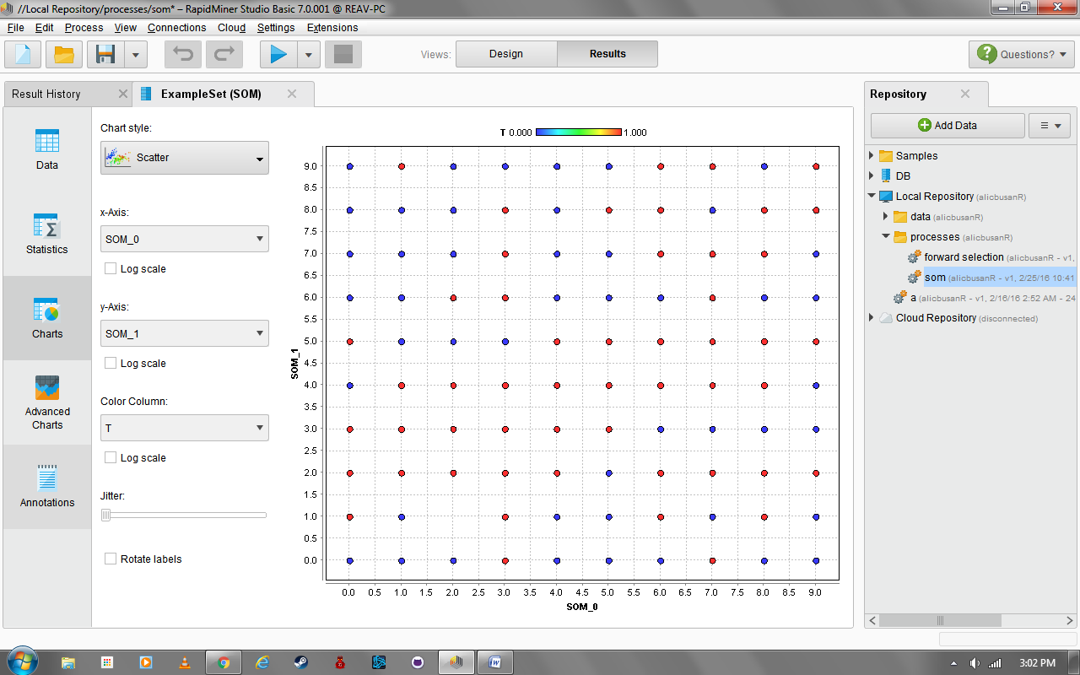
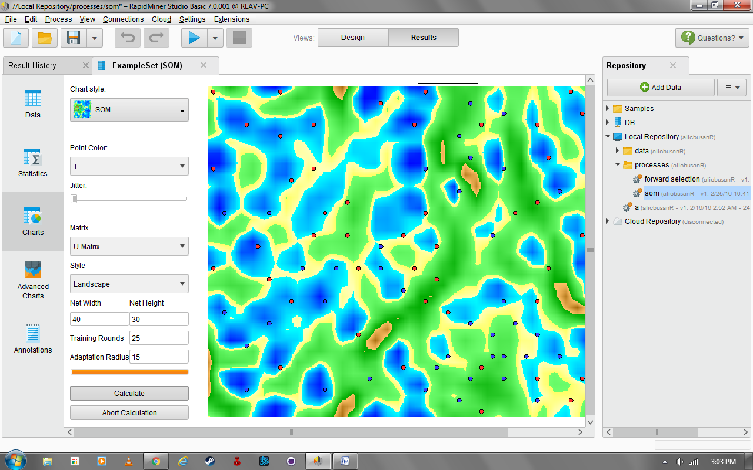
SOM: Diabetic Retinopathy
Scatter Plot and SOM:
1,000 Training Rounds

Slide 44
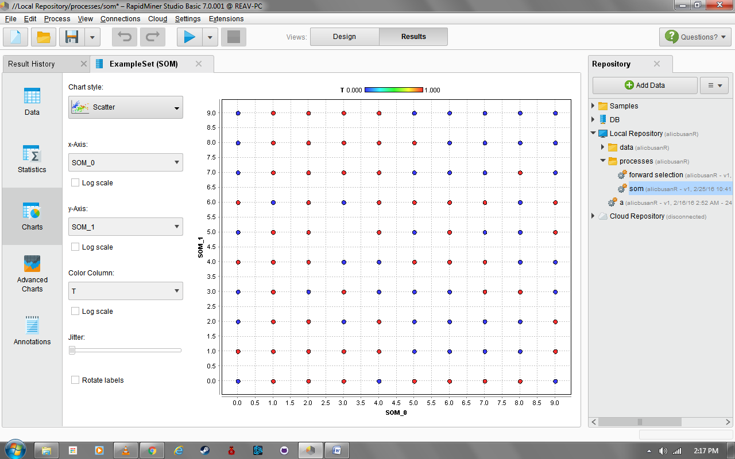
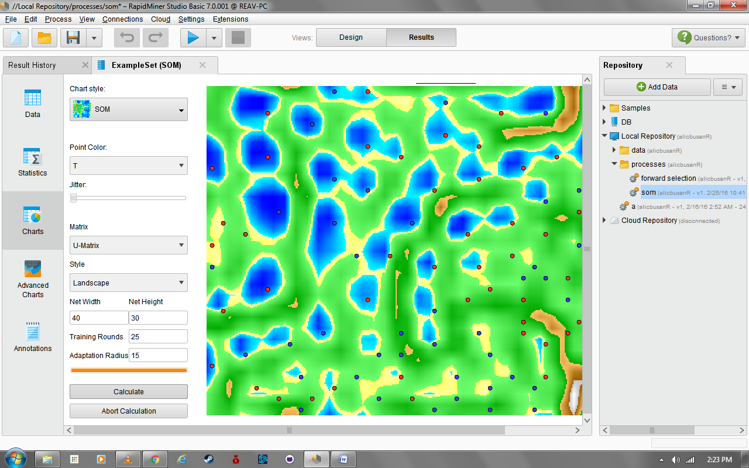
SOM: Diabetic Retinopathy
Scatter Plot and SOM-
10,000 Training Rounds

Slide 45
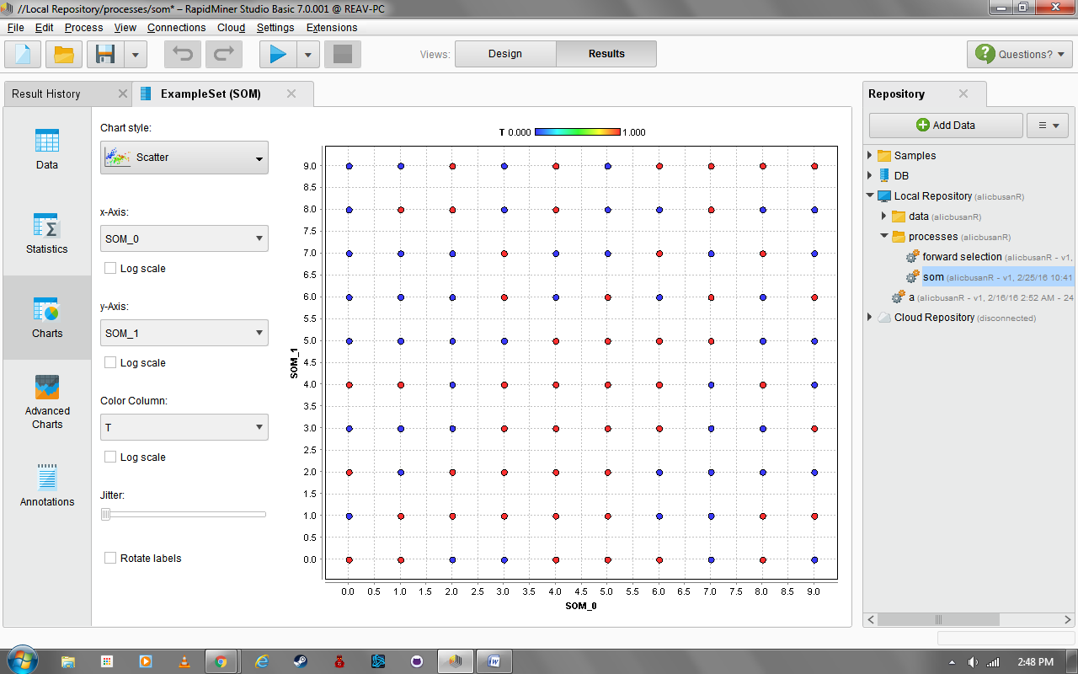
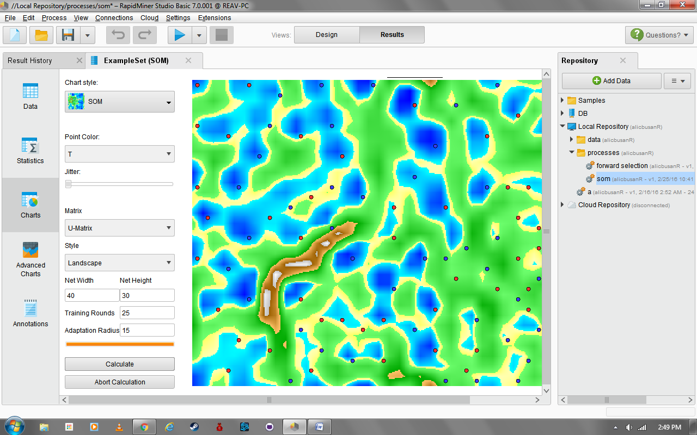
SOM: Diabetic Retinopathy
Scatter Plot and SOM –
15,000 Training Rounds

Slide 46
Discussion Of Results
All of the information here were taken at jitter set to a minimum producing a 10x10 SOM map with clear, specific, and distinct nodes that allows the classification of each sample more precise and accurate.
Although the actual relationship between each node were not discussed, this still shows a limited display of the SOM of diabetes.

